Slide 1
Notes:
Localize your welcome page….
Explain who DEA is and what we do
Here to talk about the threat to our community from fake pills and fentanyl

Slide 2
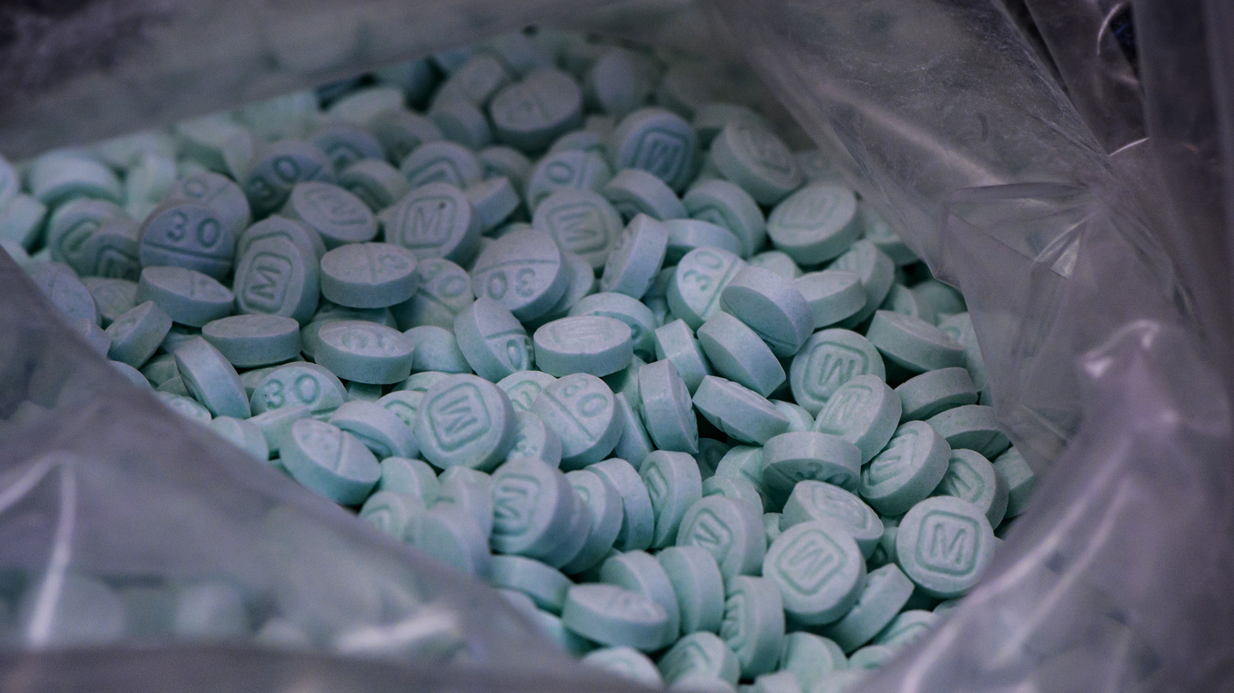
The drug overdose crisis is a clear and present public safety, public health, and national security threat.
Notes:
We are here today to talk about the drug overdose crisis. It is one of the greatest threats to the safety, health and well-being in every community across America.
DEA is doing everything it can to keep dangerous and deadly drugs out of your community, but we need your help. We need you to be educated about the dangers of today’s drugs. As we will discuss, some of these drugs are so lethal that experimenting with them just one time – could be deadly.

Slide 3
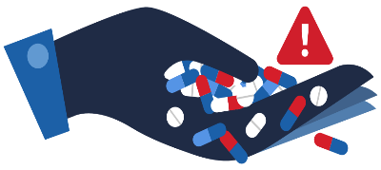
  On average, 265 people
  die of a drug overdose
  every day in the U.S.

Slide 4

Overdose Deaths
Notes:
Overdose deaths
Majority of overdose deaths are from opioids
The majority of opioid deaths are from synthetic opioids, like fentanyl

Slide 5
The record quantities of fentanyl that DEA seized
in 2023 are enough to
kill every American.
Notes:
In calendar year 2023, DEA seized more than 77 million fentanyl pills and nearly 12,000 pounds of fentanyl powder. This is the most fentanyl seized by DEA in a single year. It amounts to more than 386 million deadly doses of fentanyl—enough to kill every American.

Slide 6
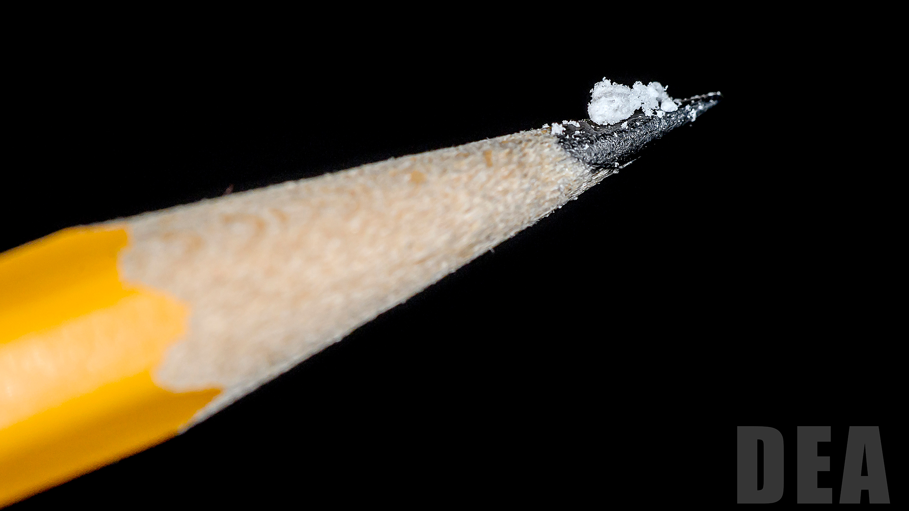
Potentially Lethal Dose of Fentanyl
Notes:
This is approximately 2 milligrams of Fentanyl and considered to be a lethal dose of fentanyl.
Fentanyl is 50 times more potent than heroin and 100 times more potent than morphine.
The fentanyl driving this crisis isn’t just sold in fake pills. Dealers are mixing fentanyl with other illicit drugs to make their product go further and increase their profits.

Slide 7

PUBLIC SAFETY ALERT
Notes:
In September 2021, DEA took the unusual step of issuing a Public Safety Alert to warn the American public about the alarming increase in lethality and availability of fake prescription pills containing fentanyl and methamphetamine.
DEA does not issue Public Safety Alerts often. As a matter of fact, prior to this alert the last one issued was over six years ago and it was to call attention to the dangers associated with fentanyl when it was first emerging as a dangerous and deadly threat.

Slide 8
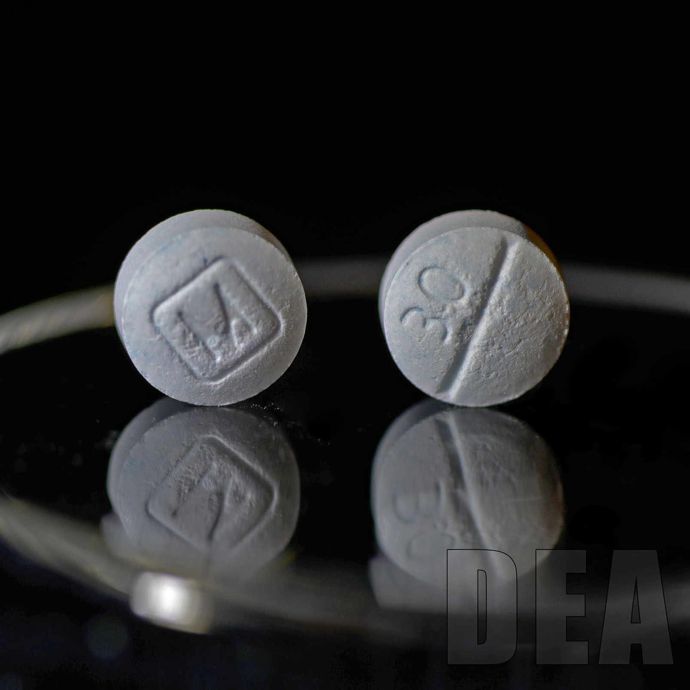
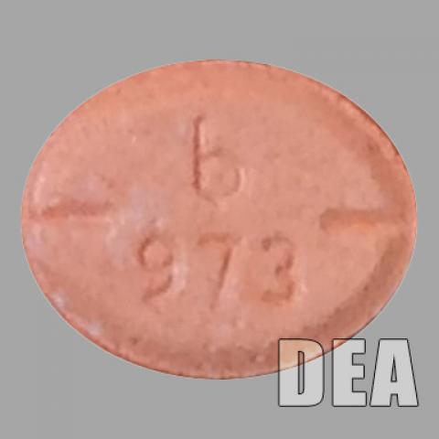
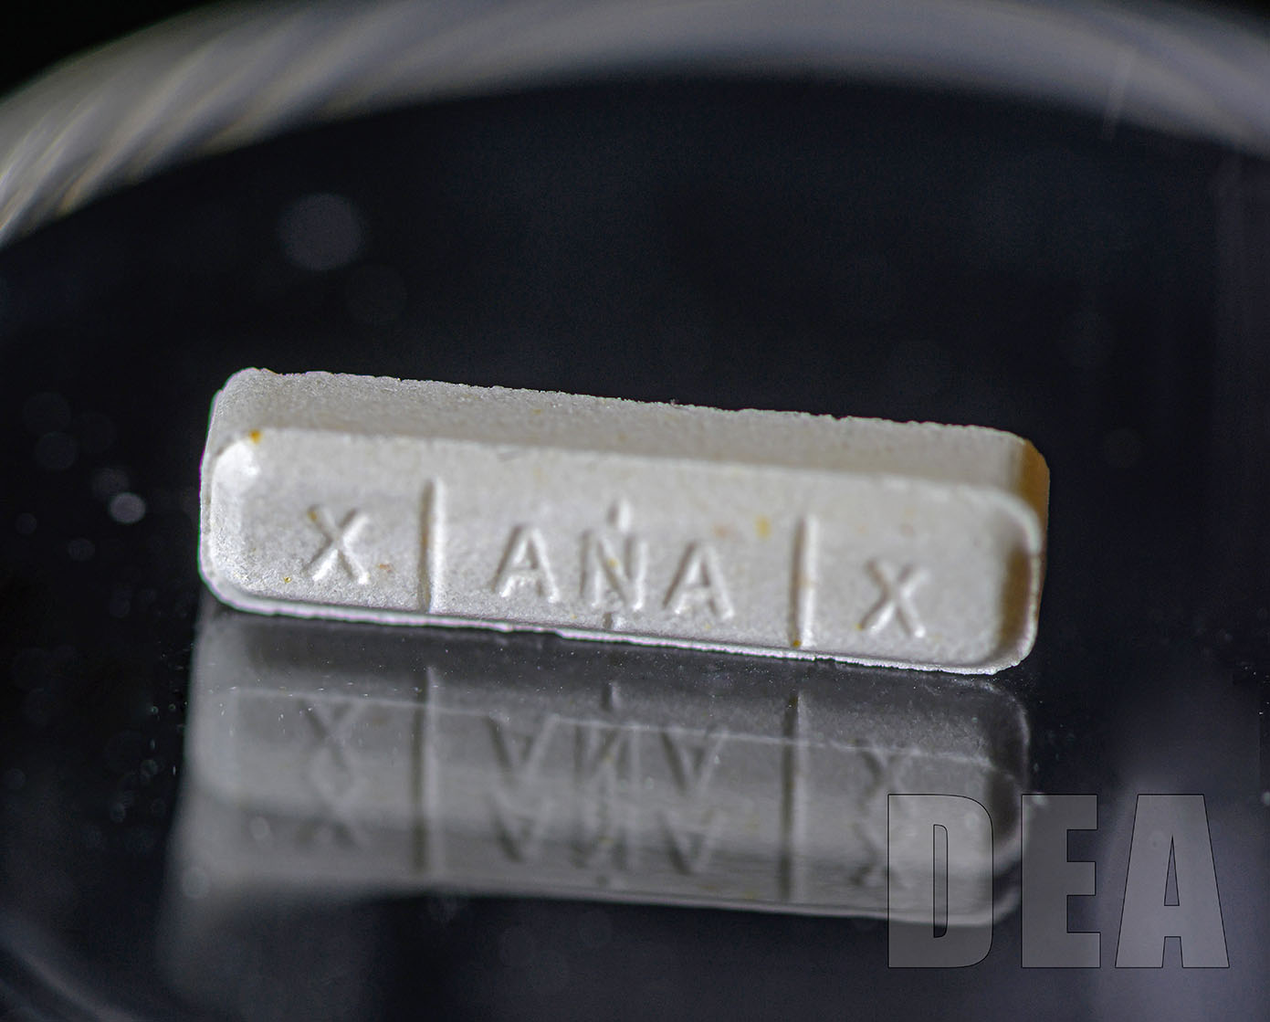
Most Common Fake Pills
Oxycontin®
Adderall®
Xanax®
Notes:
Some of the most common fake pills are made to look like prescription opioids such as oxycodone, hydrocodone (Vicodin), alprazolam (Xanax) and stimulants like amphetamines such as Adderall.
Fake prescription pills are widely accessible and often sold on social media and e-commerce platforms, making them available to anyone with a smartphone.

Slide 9
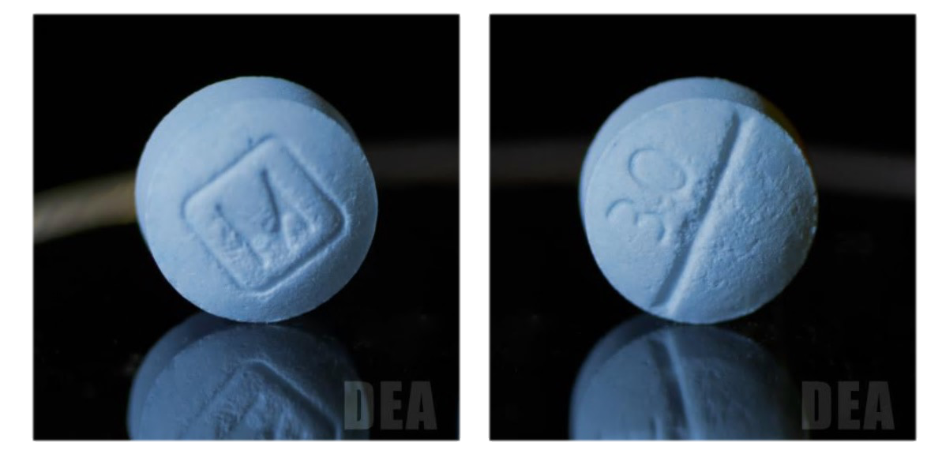
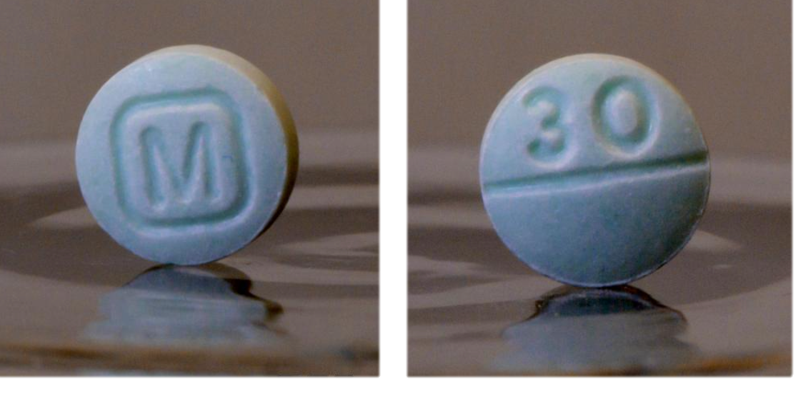
Authentic Oxycodone
Fake Oxycodone
Notes:
Let me ask you, which of these pills do you think is real? And which is the fake?

Slide 10
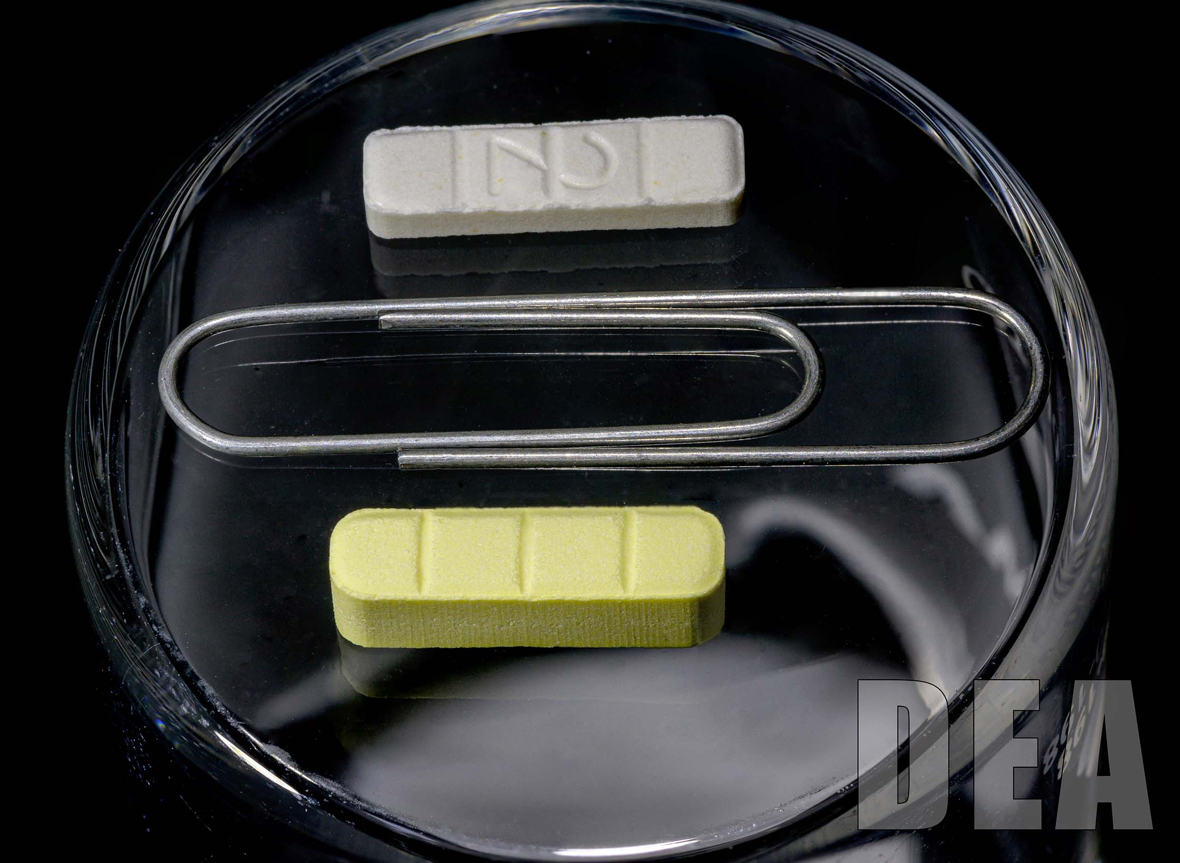
Authentic Xanax
Fake Xanax
Notes:
How about this picture?
Xanax
Real – top
Fake - Bottom
The fact of the matter is, fake pills appear nearly identical to legitimate prescription medications.
If you did not get a pill from a licensed physician or pharmacist there is no way of telling whether a pill is legitimate or fake. Even that pill your friend gives you for your headache or back pain – there is no way to tell whether they contain fentanyl or methamphetamine. Even if someone tells you it is Oxycodone, Vicodin or Adderall you can’t trust them, unless it came from a pharmacist.
Expect it to be fake – drug traffickers are preying on our dependence on pills and will market certain products as legitimate medications when they contain none of the active ingredients of those medications.

Slide 11
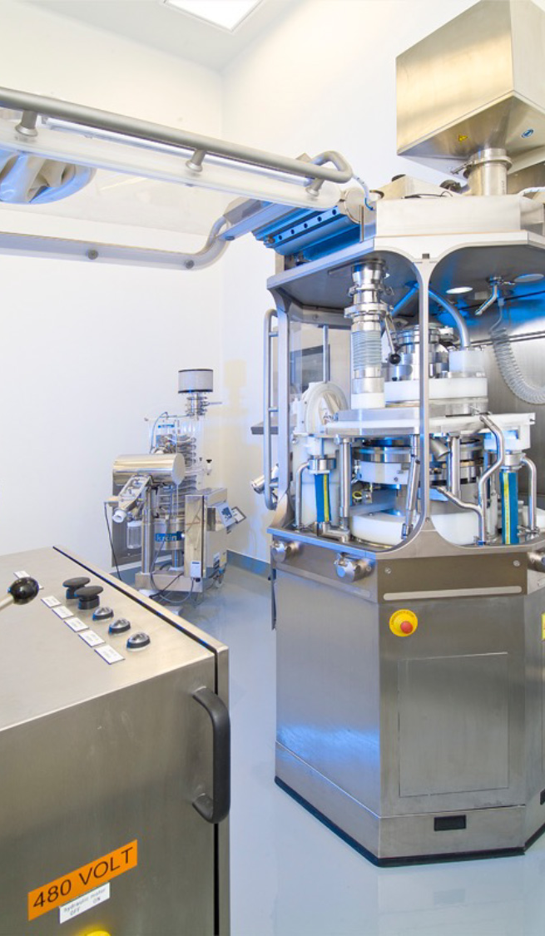
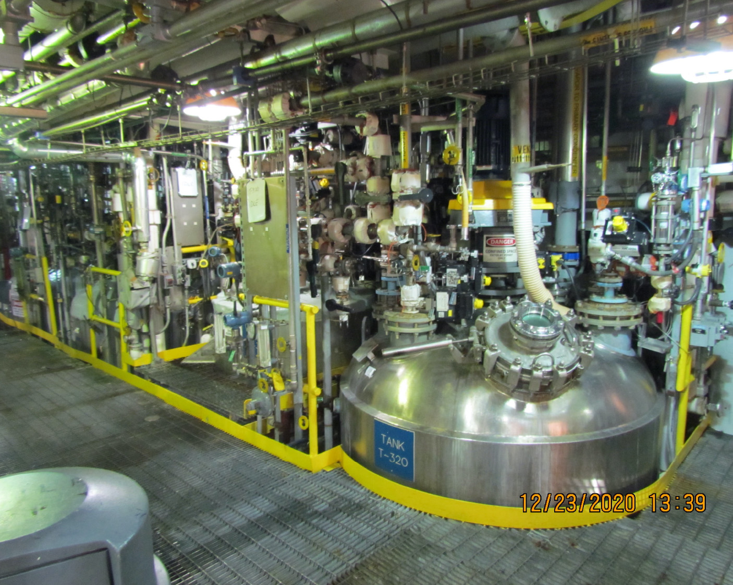
Medical grade fentanyl laboratory
Notes:
Medical grade fentanyl is made in a clean controlled laboratory, like this one, with strict regulations and taken in hospitals or nursing homes under strict medical care.

Slide 12
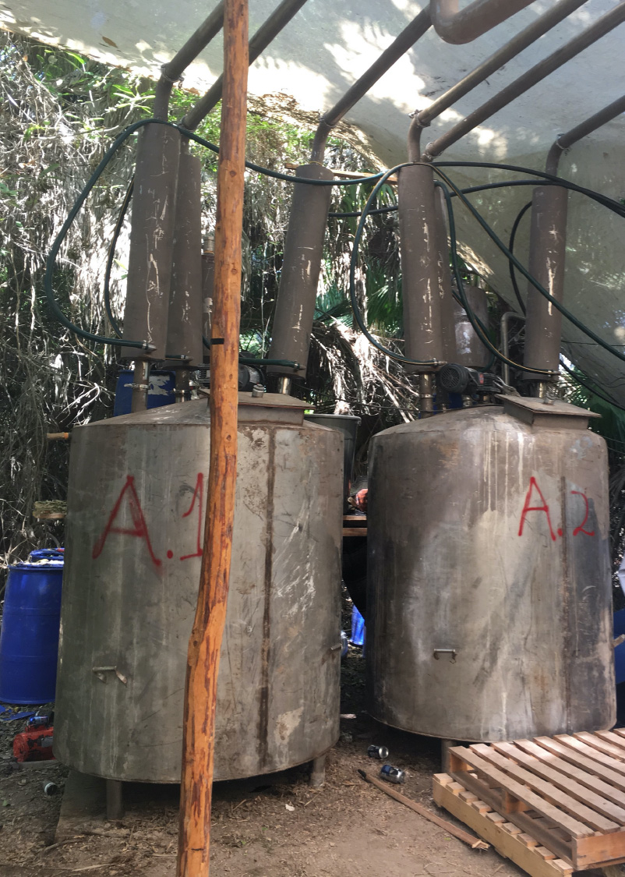
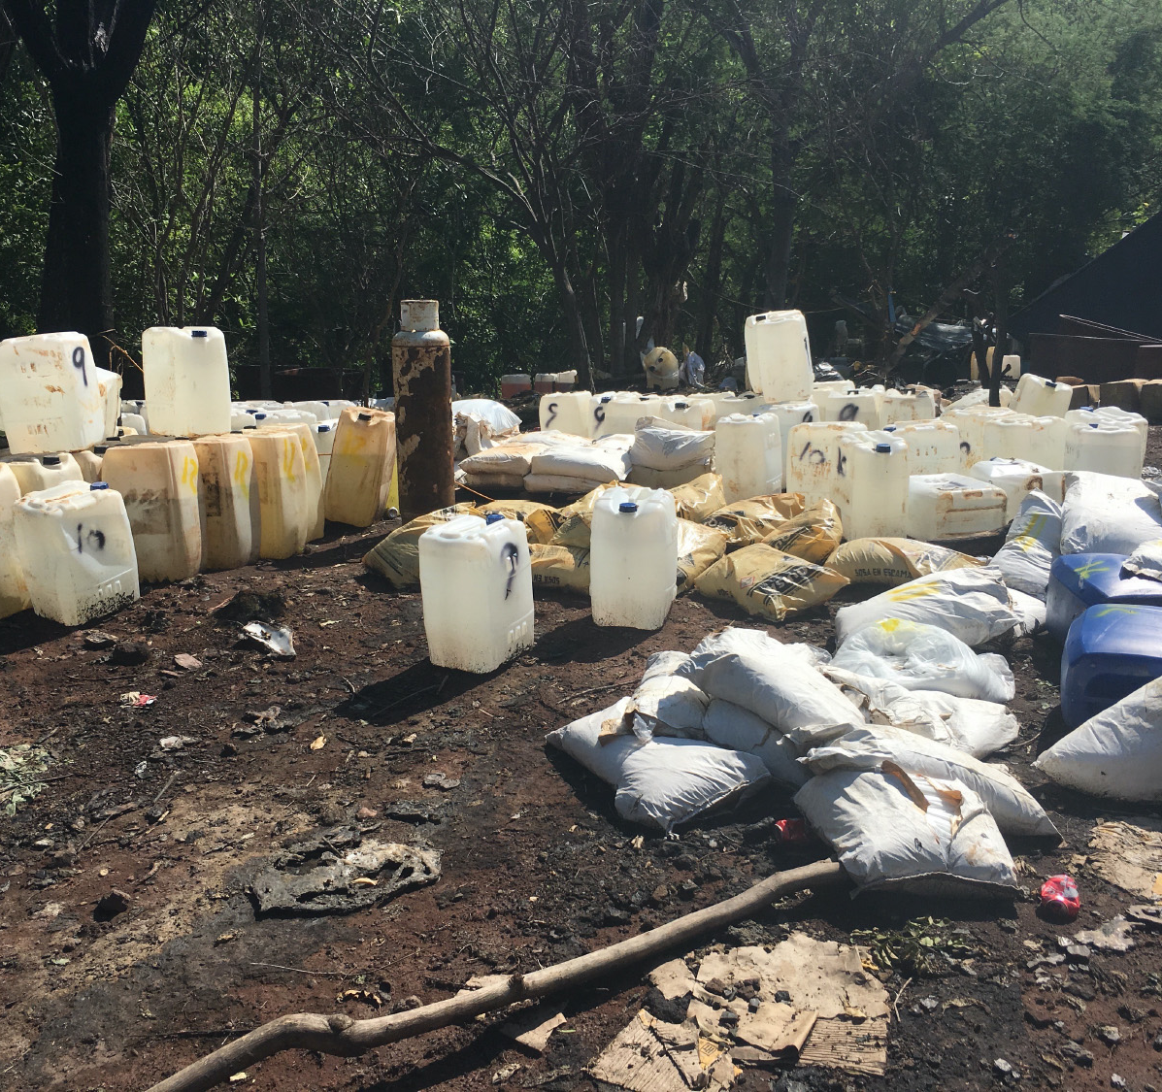
Illicit fentanyl laboratory
Notes:
But we aren’t talking about medical grade fentanyl.
We are talking about illicit fentanyl made in places like jungles, and warehouses, and garages.
There is no quality control in these operations. There is also no regard for human lives. There is no telling how much fentanyl will end up in one pill.

Slide 13
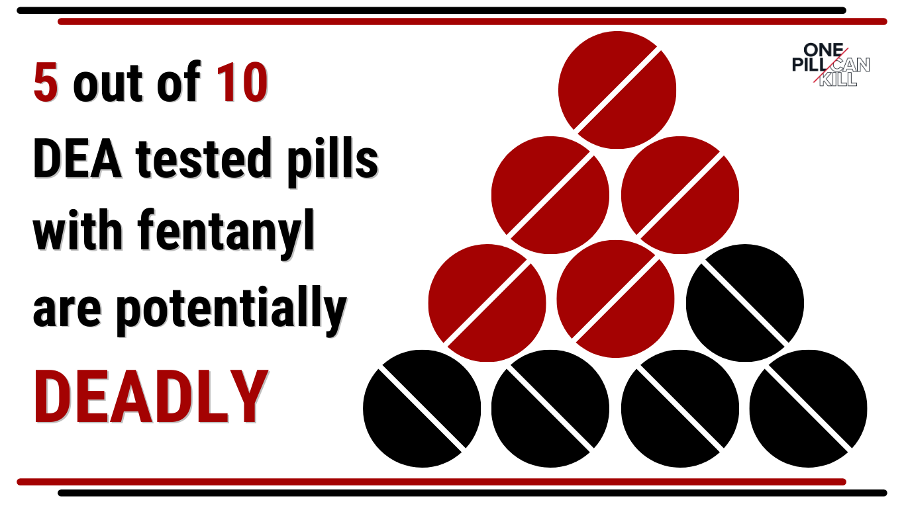
LETHAL DOSES OF FENTANYL FOUND IN FAKE PILLS
DEA reveals that five out of every ten fake pills contain at least 2mg of fentanyl – what is considered a lethal dose

Slide 14

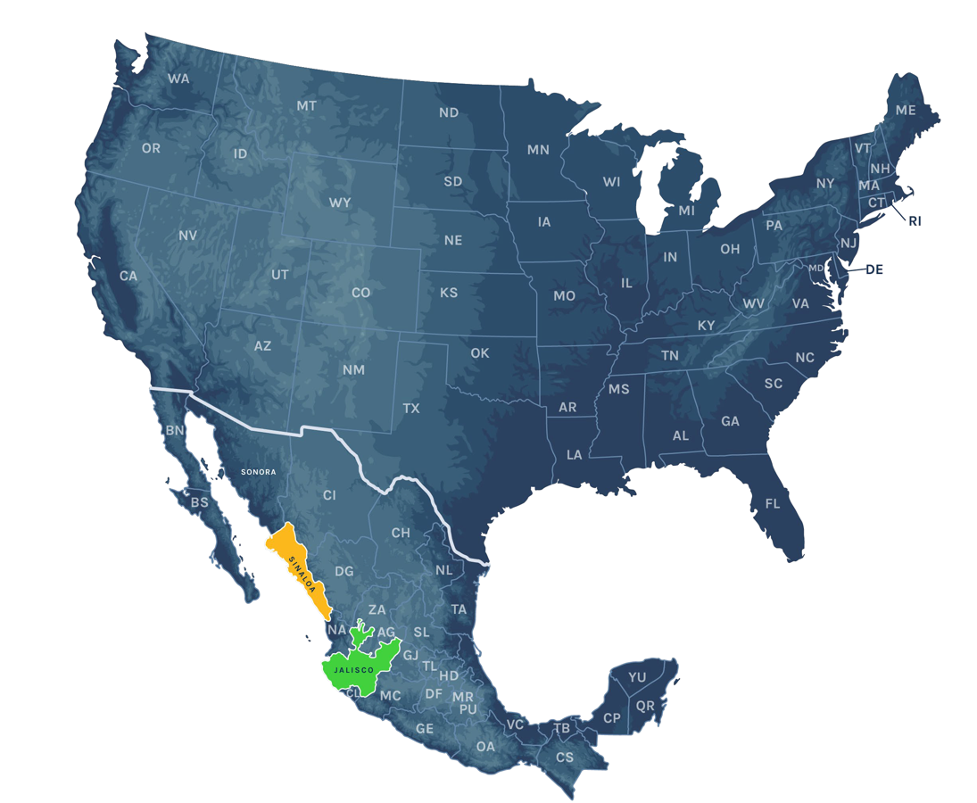



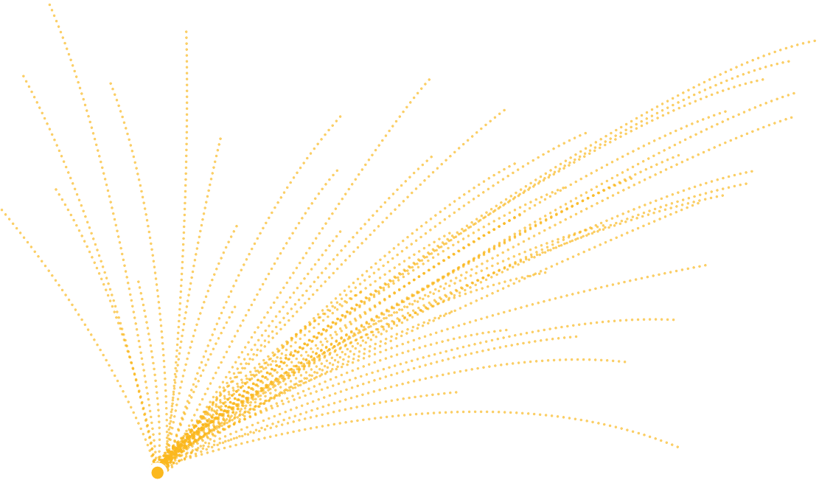





The Sinaloa and Jalisco Cartels are the criminal organizations primarily responsible for the fentanyl killing Americans
Notes:
DEA is actively targeting the two Mexico-based drug cartels that are responsible for most of the fentanyl being trafficked into American communities. They are the Sinaloa and Jalisco cartels and their criminal work reaches across the U.S.

Slide 15









GLOBAL FENTANYL SUPPLY CHAIN
1
2
3
4
5
Source precursor chemicals from China
Manufacture fentanyl into powder and pills at clandestine labs in Mexico
Smuggle fentanyl into the United States via land, sea, air, and underground
Distribute fentanyl through local criminal groups and individuals on the street and through social media
Launder drug profits through cash, goods, and cryptocurrency
Notes:
Here is an infographic that shows you the supply chain that illicit fentanyl takes on its way to American cities and towns. It starts with precursor chemicals from China that are smuggled to Mexico. In Mexico, those chemicals are manufactured into fake pills made to look like legitimate pharmaceuticals. From there, the pills are smuggled into American communities and distributed to individuals. The final step is that the profits made from the sale of these poisons are laundered back to the drug cartels and their suppliers.

Slide 16
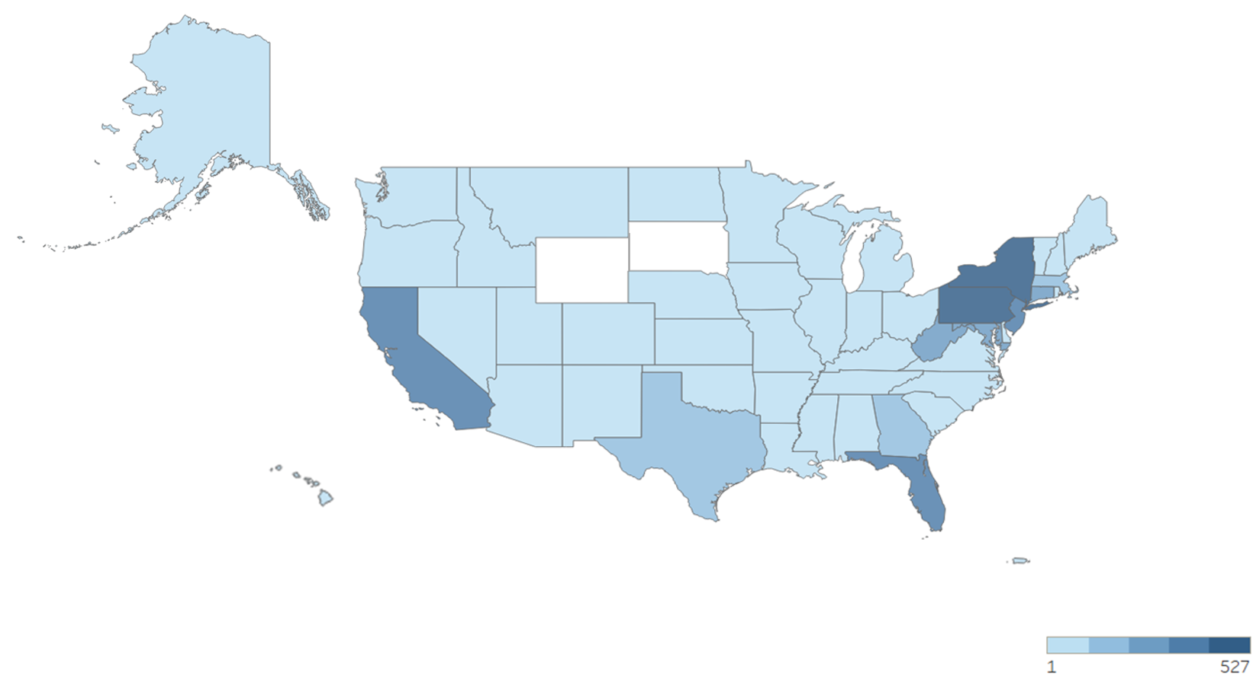
XYLAZINE AND FENTANYL
As of December 2023, the DEA Labs determined:
  5.2% of fentanyl tablets adulterated with xylazine
  27.4% of powdered fentanyl adulterated with xylazine

Slide 17
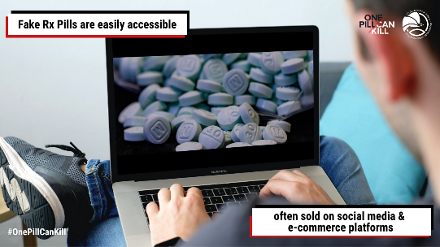
Additional Threat: Access
Fake Rx pills are easily accessible & often sold on social media &
e-commerce platforms; available to anyone with a smartphone.
Notes:
Social media sites, popular with high schoolers and young adults to share stories and pictures, have also become popular platforms for drug trafficking organizations who use the sites to sell their illicit drugs.

Slide 18
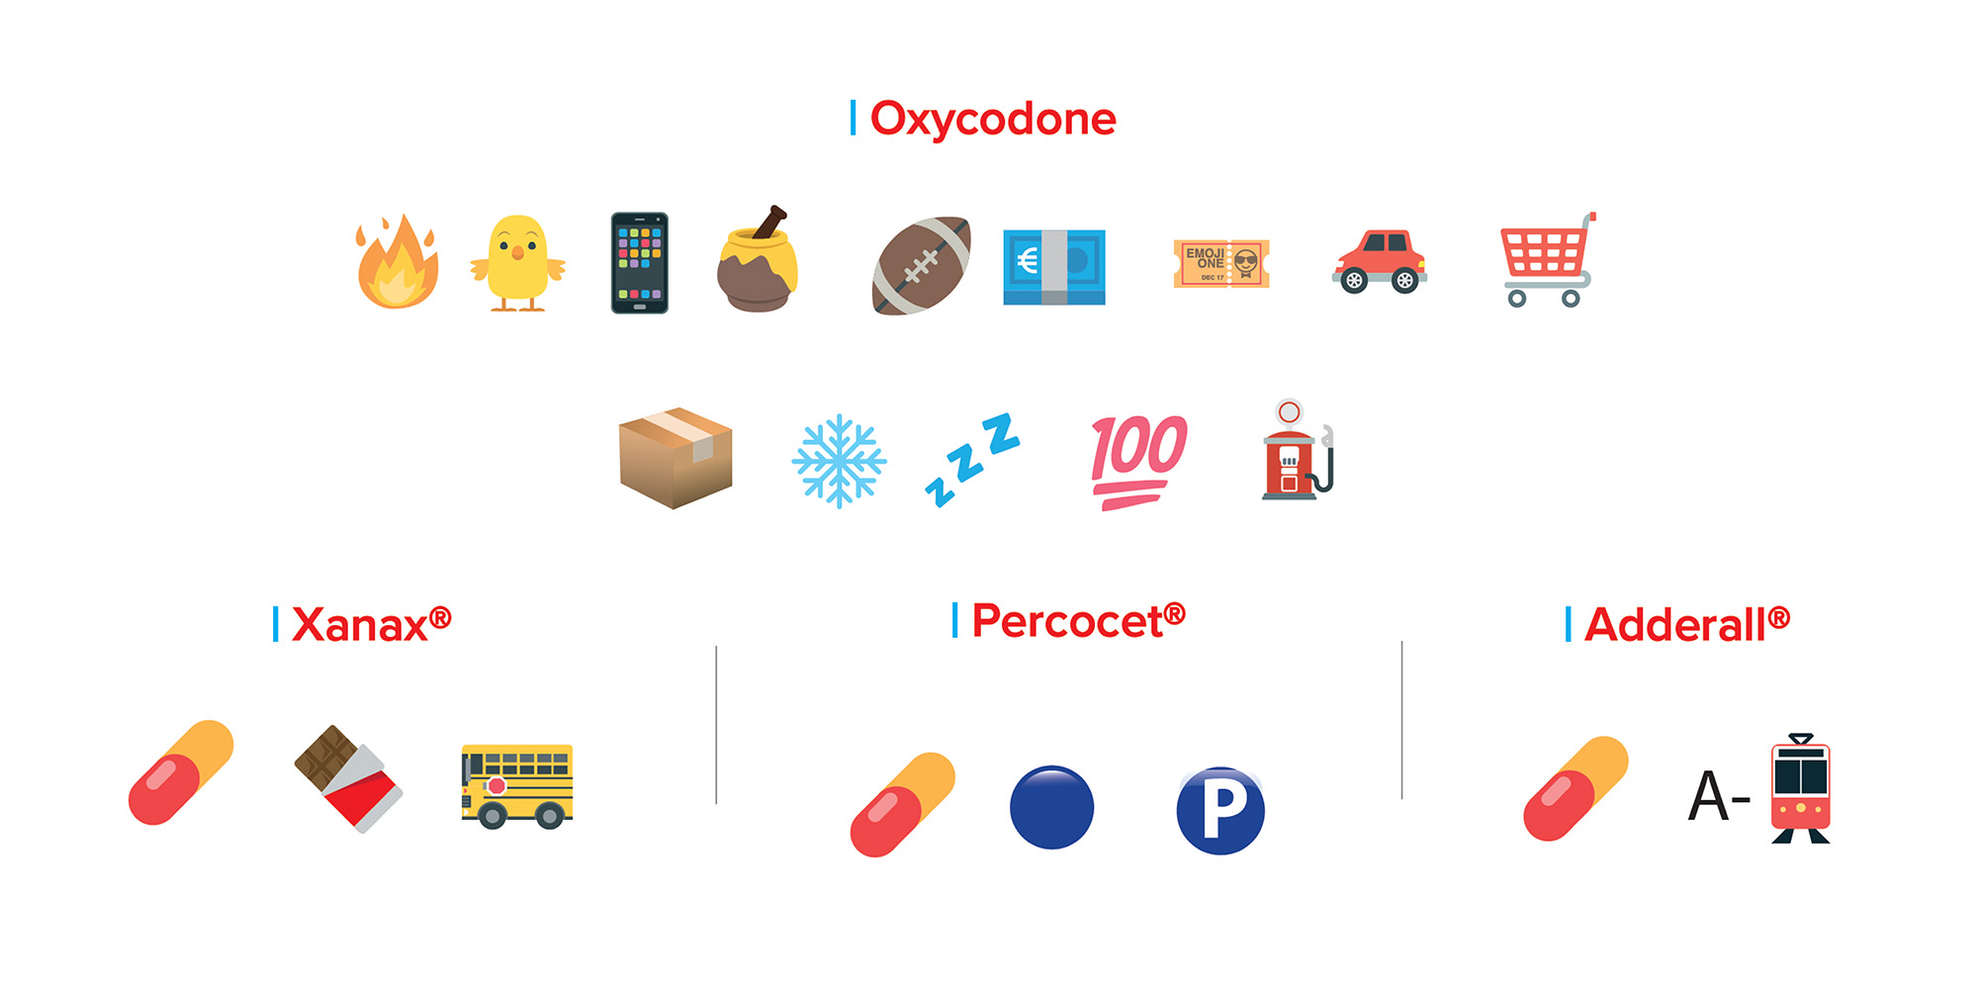
Additional Threat: Access
Popular Emoji
Drug Codes
Monitoring for suspicious text messages on social media or cash app posts could spark an important, and potentially life-saving, conversation.
Notes:
Drug traffickers and those seeking these drugs are using a whole language of emojis on social media to communicate about selling and buying these drugs.
Monitoring for suspicious text messages on social media or cash app posts could spark an important, and potentially life-saving, conversation.
DEA works with social media and internet companies to provide information that will help them better understand how dangerous drug traffickers operate in their space.

Slide 19


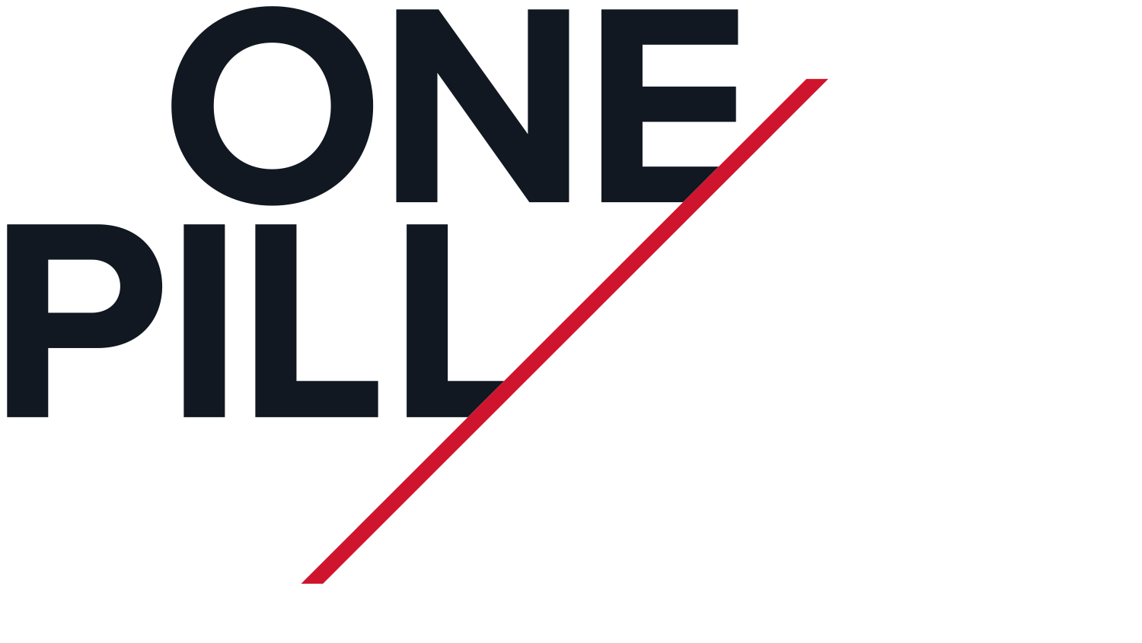
We Need Your Help
Notes:
DEA has launched “One Pill Can Kill” awareness campaign. Please help us spread the word.
Educate the general public about the dangers associated with fake pills.
Connect people with information and resources related to fake pills, fentanyl, and methamphetamine in an effort to drive down overdose deaths.
Partner with local, state and federal law enforcement, prevention and public health organizations to elevate the awareness of these dangerous and potentially deadly counterfeit pills.

Slide 20
Awareness Campaign
Know the dangers and accessibility of deadly
drugs online.
Never take medicine that wasn’t prescribed to you by your own doctor.
Talk to your family and friends about the danger of buying drugs online.
Spread the word that One Pill Can Kill.
www.dea.gov/onepill
Notes:
Encourage people to only use medications as they are prescribed to them by a licensed medical provider and dispensed by a trusted pharmacy.
Remind people to protect themselves from diversion by securing their prescription medications and cleaning out their medicine cabinets at least twice a year.
Key Messages
The drug overdose crisis in the United States is a clear and present public health, public safety, and national security threat.
One Pill Can Kill. Don’t take this warning lightly. It only takes one counterfeit pill, with a lethal dose of fentanyl, to kill you.
Only take medications that were prescribed to you by a trusted medical professional and dispensed by a licensed pharmacist.
Transnational Drug Trafficking Organizations have capitalized on the opioid epidemic and prescription drug misuse by flooding the United States with mass quantities of counterfeit prescription pills.
DEA will continue its mission to target the most dangerous individuals and organizations who are causing harm in our neighborhoods and communities; we are dedicated to reducing drug-related violence; and we must do our part to lower drug overdose deaths.
Social media sites, popular with high schoolers and young adults, to share stories and pictures have also become popular platforms for drug trafficking organizations who use the sites to sell their illicit drugs.
DEA works with social media and internet companies to provide information that will help them better understand how dangerous drug traffickers operate in their space.
The best way to affect supply is to reduce demand. One of the best ways to reduce demand is through education and awareness.

Slide 21


www.dea.gov/onepill
Notes:
If you scan this QR code it will take you right to our online resources. We encourage you to help us start and continue this important conversation. It’s never too early to talk to kids about the dangers of taking a pill that was not prescribed by a doctor and dispensed by a pharmacist. It really only takes one of these fake pills, one time, to kill.
Thank you.

